Slide 1
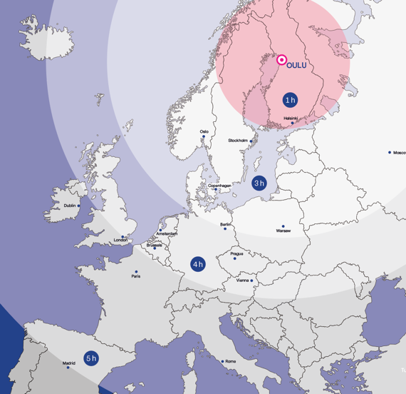
The University of Oulu in brief
Natural
Sciences and
Mathematics
Biosciences
Medicine and Health
Economics
and Business
Administration
Engineering and Architecture
Education
Humanities
Information and
Communication
Technologies
13 500
3 400
65 000+
Students
Staff
Alumni

Slide 2
Faculty of Humanities
Staff 174 | Students 1 659 | Total funding EUR 12,5M Research units and education
History, Culture and Communications
Archaeology
Cultural Anthropology
History
History of Sciences and Ideas
Information Studies
Science Communication
Giellagas Institute
Saami languages and culture
Languages and Literature
Finnish
English
Swedish
German
Logopedics

Slide 3
Research focus areas
Cultural change, interaction and human agency
Learning, language development and difficulties
Humans, well-being and environment
Northern cultures
Eudaimonia (focus institute in human sciences)

Slide 4
What kind of collaboration are we looking for?
Research/teaching/mobility collaboration desired
Student mobility
Teaching collaboration (joint UNIC courses?)

Slide 5
OULU
NORTHERN, HUMANE AND SMART OULU
HOME OF 208,000 PEOPLE
AVERAGE AGE OF RESIDENTS 39
EASILY REACHABLE NORTHERN GROWTH CENTRE

Slide 6
Thank you!

